Slide 1

Lecture 4: HTML Multimedia, Block and Form
Open Source Web Software

Slide 2
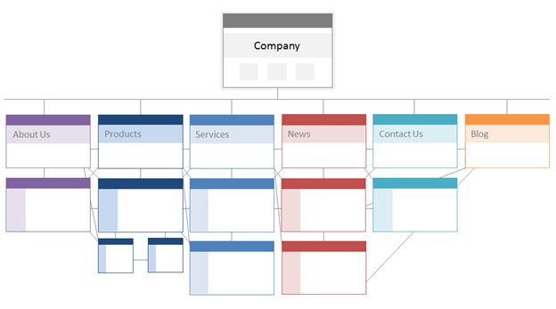
In the last lecture
HTML stands for Hyper Text Markup Language
HTML describes the structure of a Web page

Slide 3
In the last lecture
HTML heading elements
<h1> to <h6>
HTML text elements
<p>, <br>, <hr> and text formatting elements
HTML list elements
<ol> and <ul>
HTML link element
<a> and its attributes: href and target
HTML image
<image> and its attributes: width, height, alt
HTML table
<table>, <tr>, <td>, <th> and attributes: rowspan and colspan

Slide 4
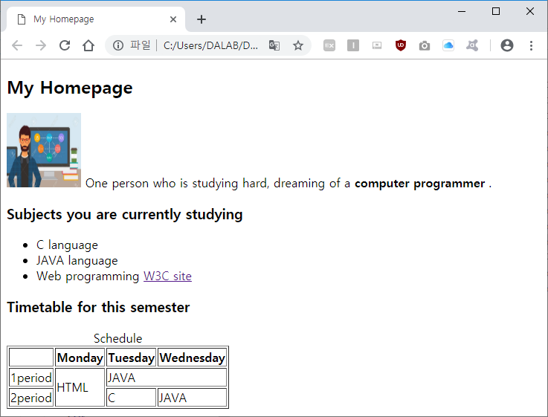
In the last lecture
Practice

Slide 5
Table of Contents
Part 3.
HTML Form Elements
Part 4.
Practice
Part 1.
HTML Blocks
Part 2.
Multimedia Elements

Slide 6
HTML Blocks
PART 1

Slide 7
HTML Blocks
Every HTML element has a default display value depending on what type of element it is.
The two display values are: block and inline.
Block elements
<h1> ~ <h6>, <p>, <hr>, <ul>, <ol>, <li>, <table>, <div>
Inline elements
<a>, <img>, <b>, <strong>, <i>, <em>, <sub>, <sup>, <span>, <label>

Slide 8
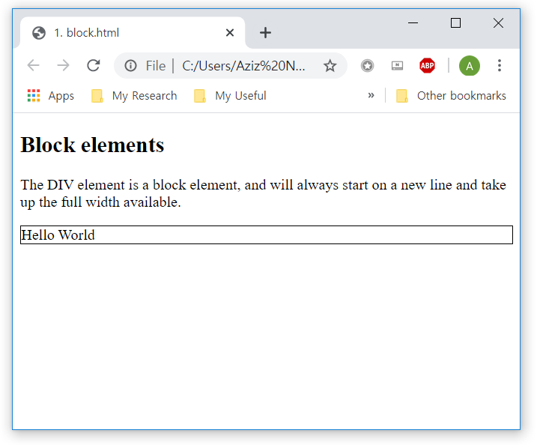
HTML Blocks
Block-level Elements
A block-level element always starts on a new line and takes up the full width available
<!DOCTYPE html>
<html>
…
<body>
<h2>Block elements</h2>
<p> A block-level element always starts
on a new line and takes up the full
width available.</p>
<div style="border: 1px solid black">
Hello World</div>
</body>
</html>

Slide 9
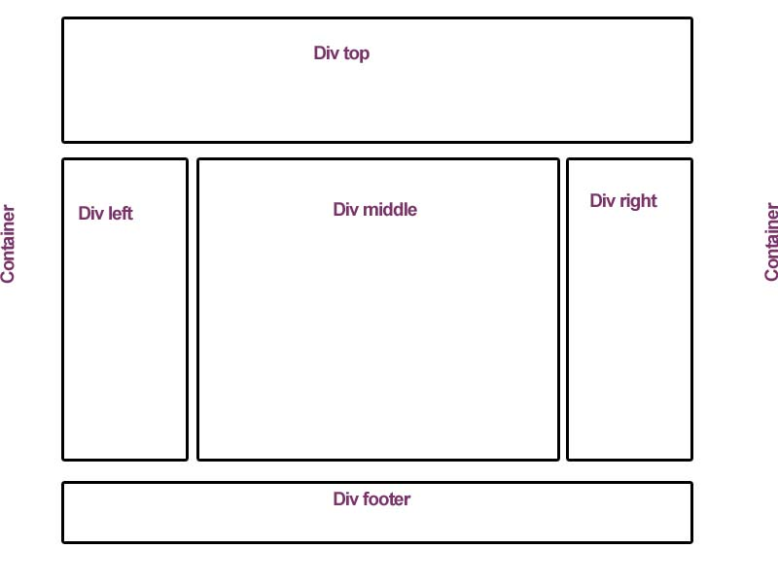
HTML Blocks
<div>
Stands for “divide“ and is used for divide the page into logical sections
Tip: Very often used together with CSS, to layout a web page

Slide 10
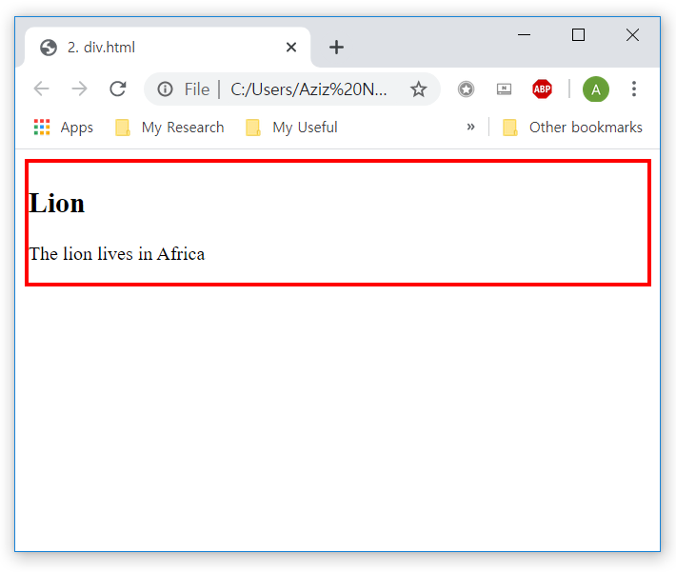
HTML Blocks
<div>
Often used as a container for other HTML elements
<!DOCTYPE html>
<html>
…
<body>
<div style="border: 3px solid red">
<h2>Lion</h2>
<p>The lion lives in Africa</p>
</div>
</body>
</html>

Slide 11
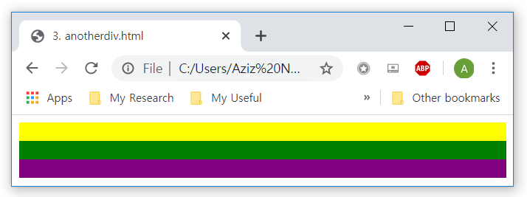
HTML Blocks
<div>
Example
<!DOCTYPE html>
<html>
<body>
<div style="height:20px; background-color:yellow"></div>
<div style="height:20px; background-color:green"></div>
<div style="height:20px; background-color:purple"></div>
</body>
</html>
Don’t forget semicolon here

Slide 12
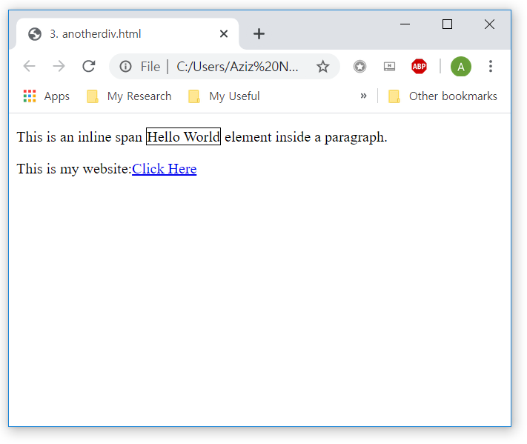
HTML Blocks
Inline elements
Does not start on a new line and only takes up as much width as necessary
<span> is used as a container for some text
<!DOCTYPE html>
<html>
…
<body>
<p>This is an inline span <span
style="border: 1px solid black">Hello
World</span> element inside a
paragraph.
</p>
<p>This is my website:<a
href="www.google.com">Click
Here</a>
</p>
</body>
</html>

Slide 13
Html multimedia elements
Part 2

Slide 14

HTML Multimedia Elements
What is Multimedia?
Multimedia comes in many different formats
It can be almost anything you can hear or see
Before HTML5, we used to have Adobe Flash to embed multimedia in our website
HTML5 has built-in multimedia tags

Slide 15
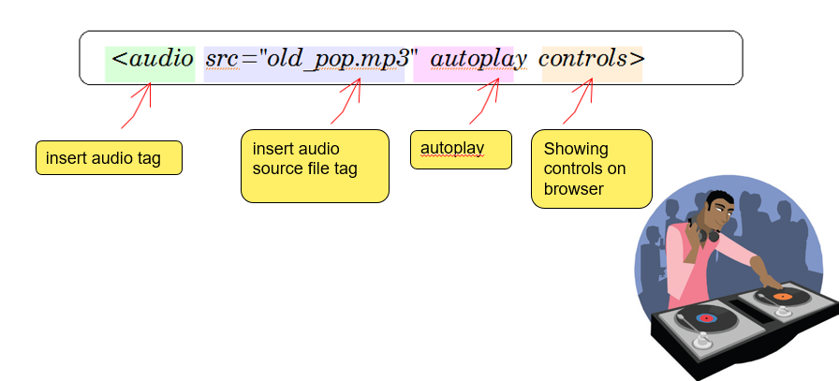
HTML Multimedia Elements
Audio element

Slide 16
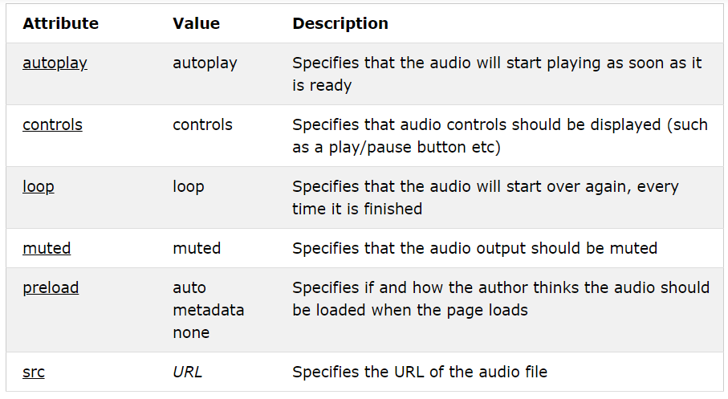
HTML Multimedia Elements
Attributes of audio element

Slide 17
HTML Multimedia Elements
Audio file formats
MP3 – MPEG stands for 'MPEG-1 Audio Layer-3‘ and is a audio file compression format
Wav – A standard format used in Windows OS
Ogg - It was developed as open source for better sound quality as opposed to patent

Slide 18
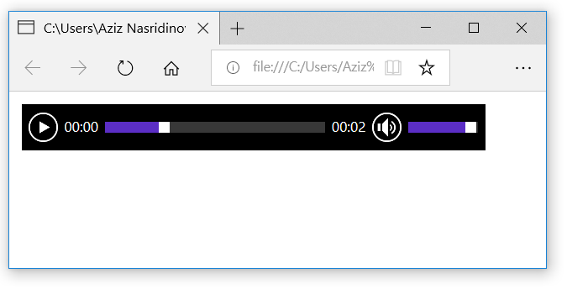
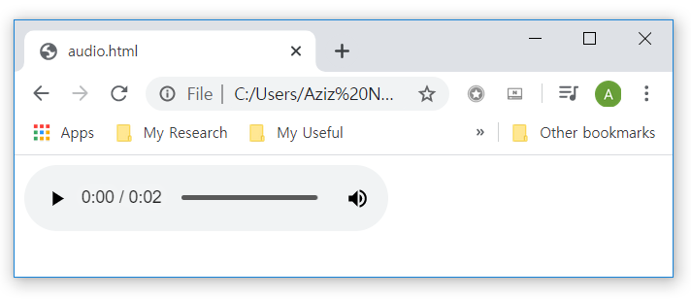
HTML Multimedia Elements
Audio file format
Example
<!DOCTYPE html>
<html>
…
<body>
<audio src="horse.mp3" controls
autoplay loop>
Your browser does not
support the audio element.
</audio>
</body>
</html>

Slide 19
HTML Multimedia Elements
Audio file format
Example
<!DOCTYPE html>
<html>
…
<body>
<audio controls autoplay loop>
<source src="horse.mp3">
Your browser does not
support the audio element.
</audio>
</body>
</html>

Slide 20
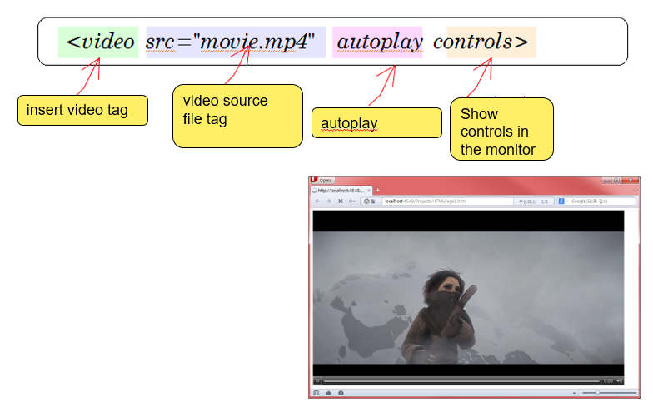
HTML Multimedia Elements
Video element

Slide 21
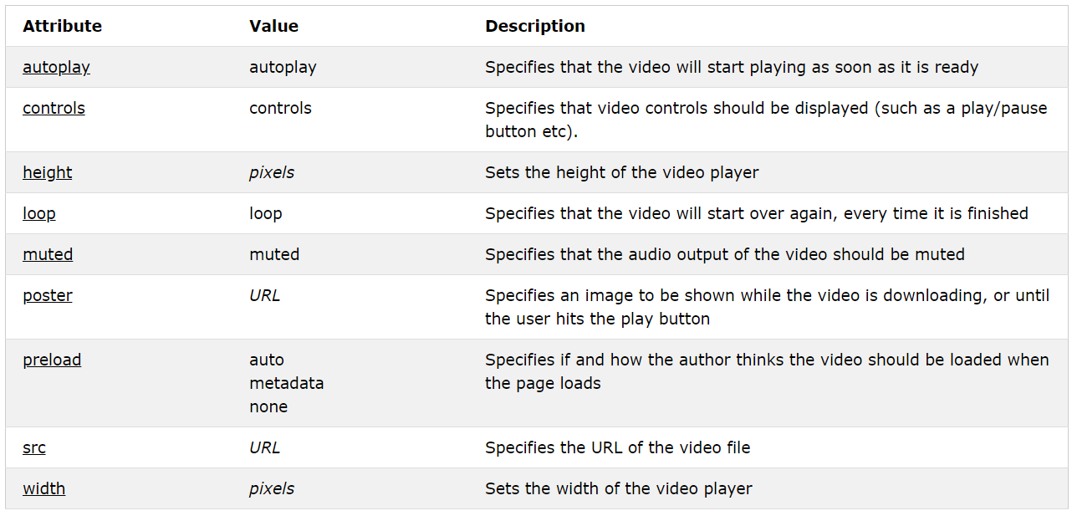
HTML Multimedia Elements
Attributes of video element

Slide 22
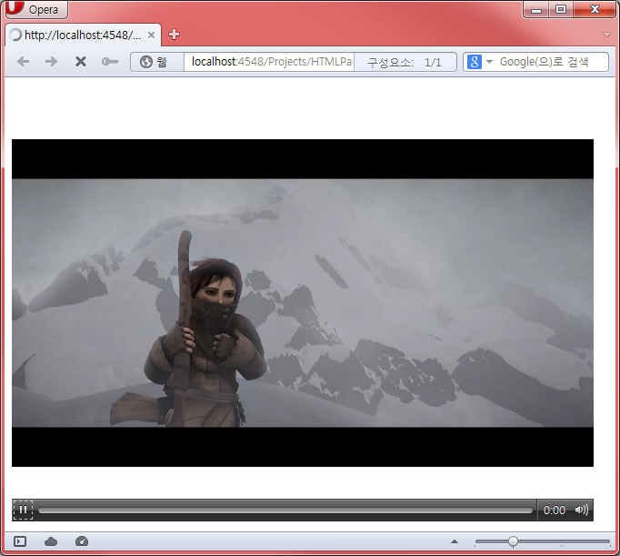
HTML Multimedia Elements
Video element
Example
<!DOCTYPE html>
<html>
…
<body>
<video width="640" height="480" controls>
<source src="trailer.mp4" type='video/mp4'>
<source src="trailer.ogv" type='video/ogg'>
Your browser does not support video element
</video>
</body>
</html>

Slide 23
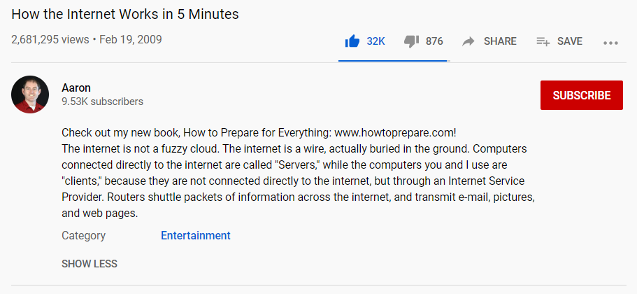
HTML Multimedia Elements
Struggling with Video Formats?
You can embed Youtube videos into your page

Slide 24
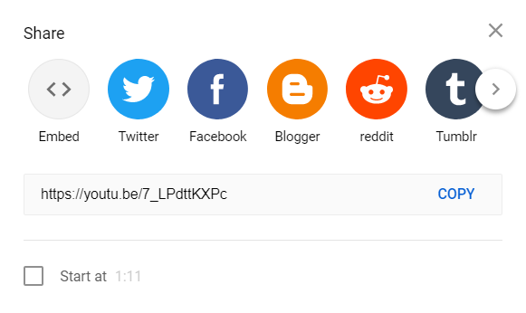
HTML Multimedia Elements
Struggling with Video Formats?
You can embed Youtube videos into your page

Slide 25
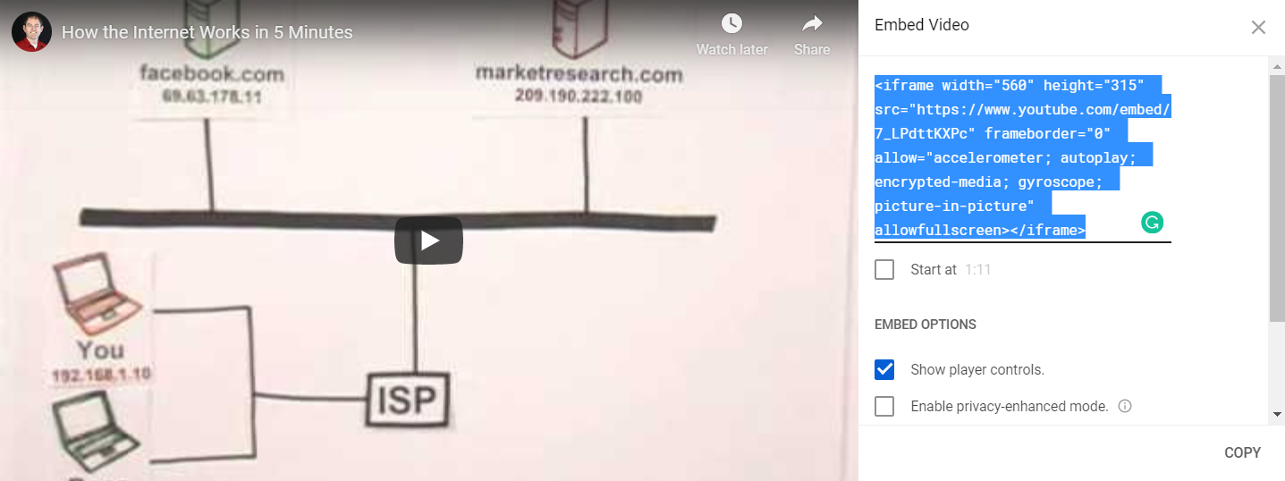
HTML Multimedia Elements
Struggling with Video Formats?
You can embed Youtube videos into your page
Copy this code

Slide 26
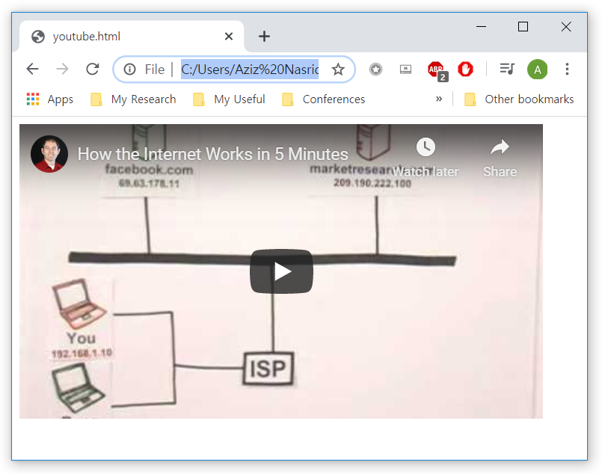
HTML Multimedia Elements
Struggling with Video Formats?
You can embed Youtube videos into your page
<!DOCTYPE html>
<html>
…
<body>
<iframe width="560" height="315" src="https://www.youtube.com/embed/7_LPdttKXPc" frameborder="0" allow="accelerometer; autoplay; encrypted-media; gyroscope; picture-in-picture" allowfullscreen></iframe>
</body>
</html>

Slide 27
Html FORM elements
Part 3

Slide 28
HTML Form Elements
The HTML <form> element
Defines a form that is used to collect user input
An HTML form contains form elements.
Form elements are different types of input elements, like:
Text fields
Checkboxes
radio buttons
more.

Slide 29
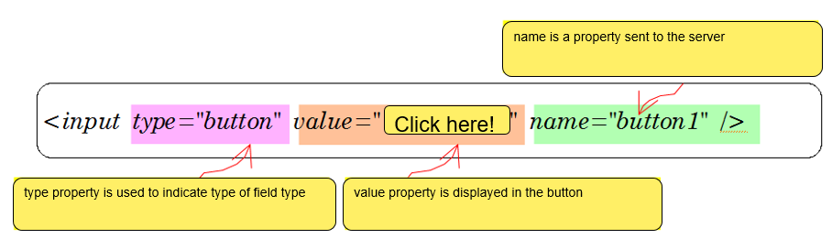
HTML Input Elements
Input elements
Needed for describe input fields

Slide 30
HTML Input Elements
<input type="text">
<input type="password">
<input type="submit">
<input type="reset">
<input type="radio">
<input type="range">
<input type="search">
<input type="tel">
<input type="time">
<input type="url">
<input type="week">
<input type="button">
<input type="checkbox">
<input type="color">
<input type="date">
<input type="datetime-local">
<input type="email">
<input type="file">
<input type="hidden">
<input type="image">
<input type="month">
<input type="number">

Slide 31
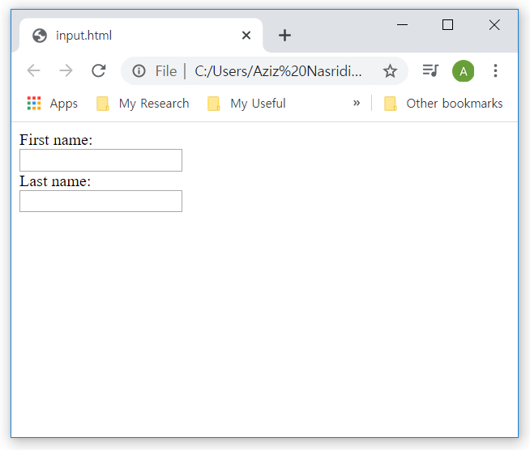
HTML Input Elements
<input type="text">
Defines a single-line text input field
<!DOCTYPE html>
<html>
…
<body>
<form>
<label>First name:</label><br>
<input type="text"><br>
<label>Last name: /label><br>
<input type="text"><br>
</form>
</body>
</html>

Slide 32
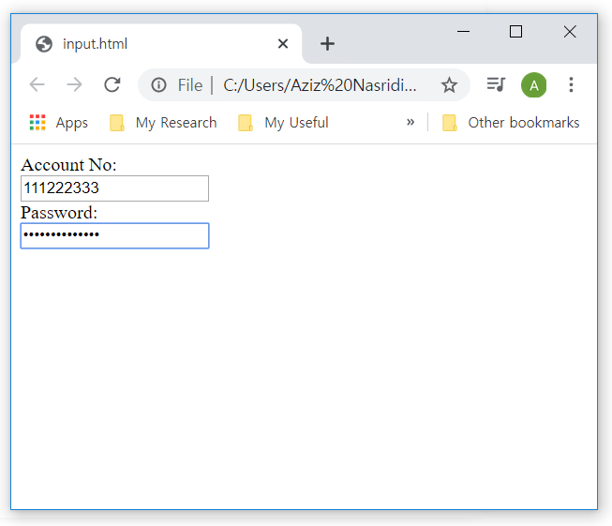
HTML Input Elements
<input type="password">
Defines a password field
<!DOCTYPE html>
<html>
…
<body>
<form>
<label>Account No:</label><br>
<input type="text"><br>
<label>Password:</label><br>
<input type="password"><br>
</form>
</body>
</html>

Slide 33
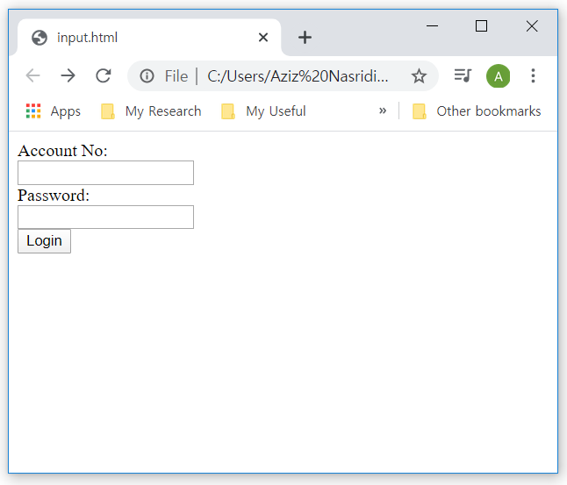
HTML Input Elements
<input type="submit">
Defines a button for submitting form data
If you omit the submit button's value attribute, the button will get a default text “Submit”
<!DOCTYPE html>
<html>
…
<body>
<form>
<label>Account No:</label><br>
<input type="text"><br>
<label>Password:</label><br>
<input type="password"><br>
<input type="submit"
value="Login">
</form>
</body>
</html>

Slide 34
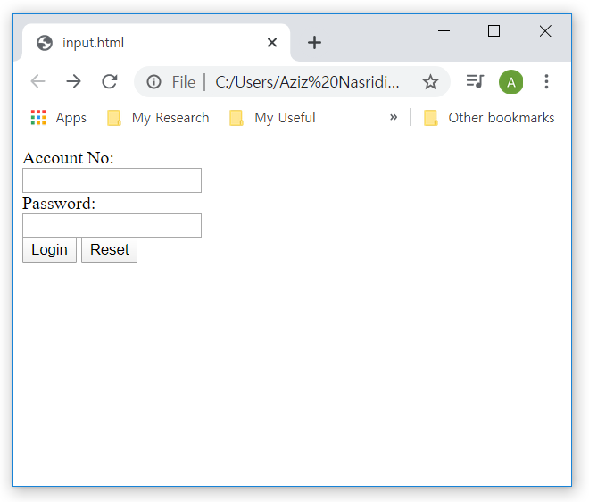
HTML Input Elements
<input type="reset">
Defines a reset button that will reset all form values
<!DOCTYPE html>
<html>
…
<body>
<form>
<label>Account No:</label><br>
<input type="text"><br>
<label>Password:</label><br>
<input type="password"><br>
<input type="submit"
value="Login">
<input type="reset">
</form>
</body>
</html>

Slide 35
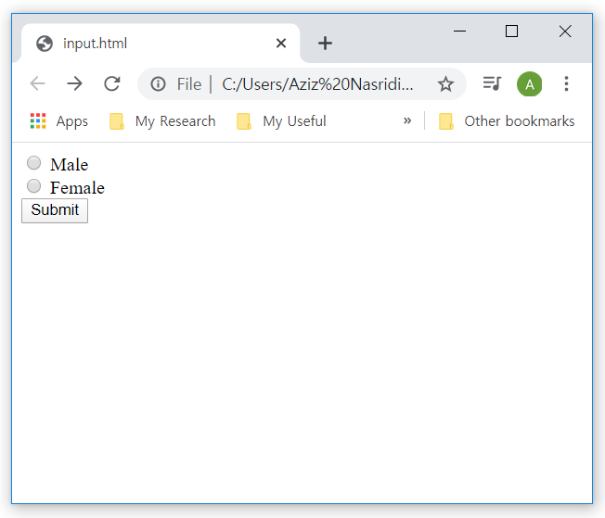
HTML Input Elements
<input type="radio">
Defines a radio button
<!DOCTYPE html>
<html>
…
<body>
<form>
<input type="radio">
<label>Male</label><br>
<input type="radio">
<label>Female</label><br>
<input type="submit“
value="Submit">
</form>
</body>
</html>

Slide 36
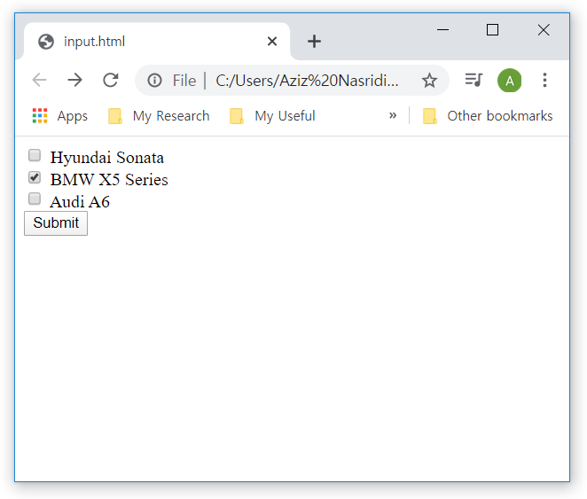
HTML Input Elements
<input type="checkbox">
Defines a checkbox
<!DOCTYPE html>
<html>
…
<body>
<form>
<input type="checkbox">
<label>Hyundai</label><br>
<input type="checkbox" checked>
<label>BMW X5</label><br>
<input type="checkbox">
<label>Audi A6</label><br>
<input type="submit"
value="Submit">
</form>
</body>
</html>

Slide 37
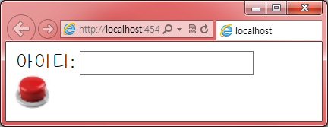
HTML Input Elements
Image button
<form>
ID:
<input type="text">
<input type="image" src="submit.png" alt=“Submit Button">
</form>
ID
ID

Slide 38
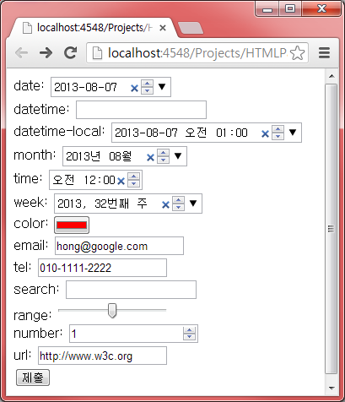
HTML Input Elements
<body>
<form>
date: <input type="date"> <br>
datetime: <input type="datetime"> <br>
datetime-local: <input type="datetime-local"><br>
month: <input type="month"> <br>
time: <input type="time"> <br>
week: <input type="week"> <br>
color: <input type="color"> <br>
email: <input type="email"> <br>
tel: <input type="tel"> <br>
search: <input type="search"> <br>
range: <input type="range"> <br>
number: <input type="number"> <br>
url: <input type="url"> <br>
<input type="submit">
</form>
</body>

Slide 39
Summary and Discussions
HTML multimedia elements
audio and video elements
HTML iframe element
Recently most of the websites do not support iframes
HTML block elements
<div> means divide and used for logically organize your website
HTML input elements
Various kinds of <input> elements

Slide 40
Practice
Part 4

Slide 41
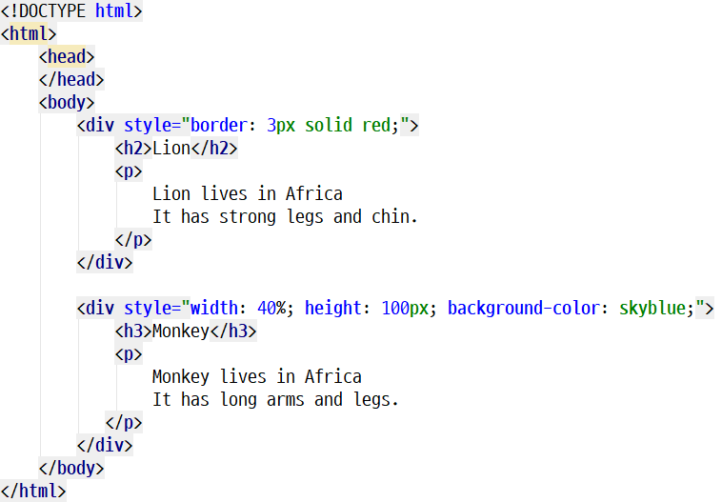
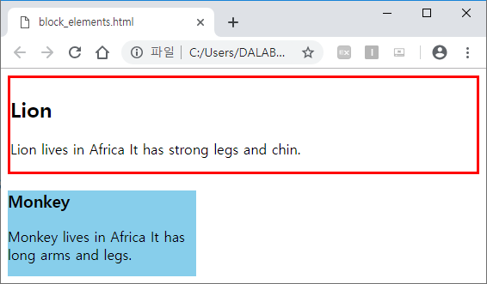
HTML Blocks
<div>
Used for creating layout
Block element
block_elements.html

Slide 42
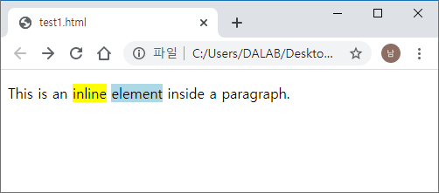
HTML Blocks
Inline elements
Does not start on a new line and only takes up as much width as necessary
<span> is used as a container for some text
<!DOCTYPE html>
<html>
…
<body>
<p>This is an
<span style="background-color: yellow;">inline</span>
<span style="background-color: lightblue;">element</span>
inside a paragraph.</p>
</body>
</html>

Slide 43
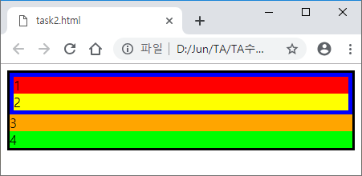
HTML Blocks
Task 1
Create the following web page using <div> tag and style attribute
1. 3px solid black
2. 5px solid blue

Slide 44
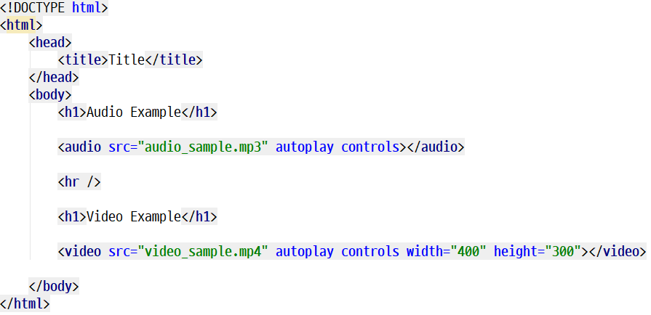
HTML Multimedia Elements
Audio and video elements
Try the following example
multimedia_elements.html

Slide 45
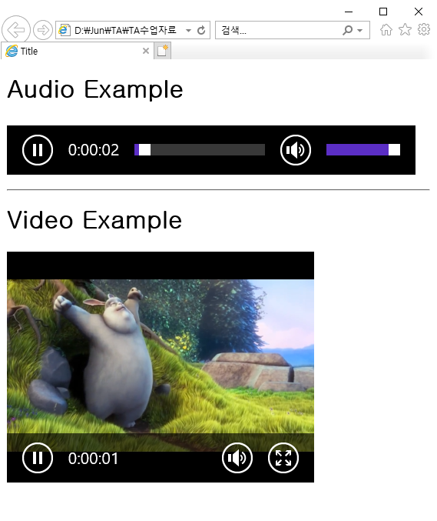
HTML Multimedia Elements
Audio and video elements
Try the following example

Slide 46
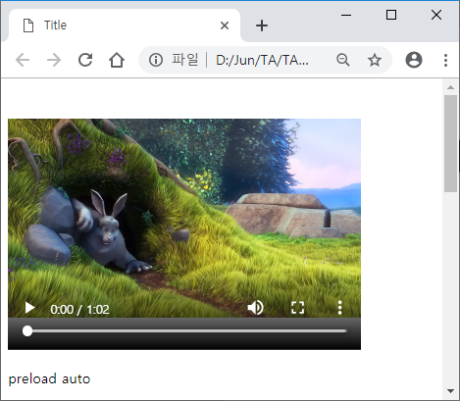
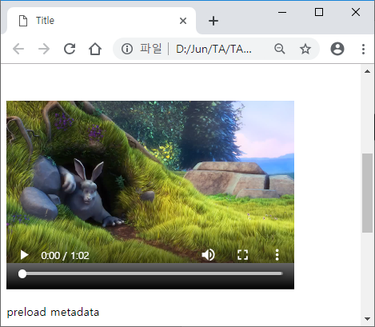
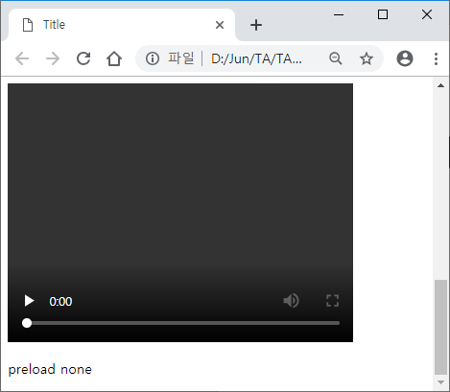
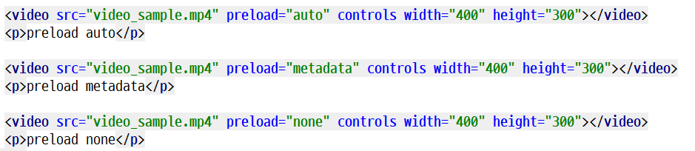
HTML Multimedia Elements
Try each of preload by yourself
auto
metadata
none
multimedia_elements(2).html

Slide 47

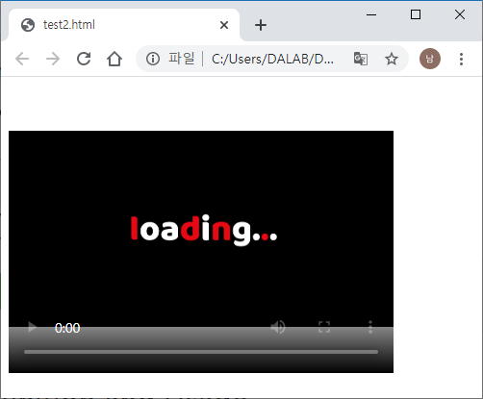
HTML Multimedia Elements
Video element
Poster : An image to be shown while the video is downloading, or until the user hits the play button.

Slide 48
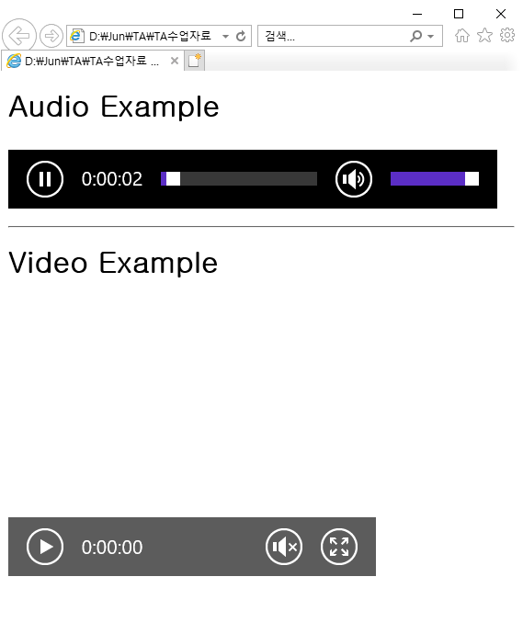
HTML Multimedia Elements
Task 2
Create the following web pages using audio and video tags
Include autoplay
Include loop
Include controls
Run on IE
Include muted
Preload: none
Include controls
Include width
and height
5. Run on Chrome

Slide 49
HTML Form Elements
Attributes of input element
autofocus - when the page is loaded, focuses automatically
placeholder – input hint is shadowed
readonly - a read-only field
required - indicates that the input form should be filled out before submission

Slide 50
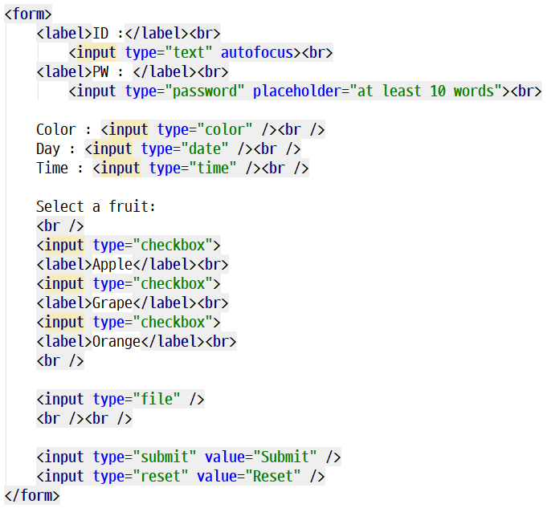
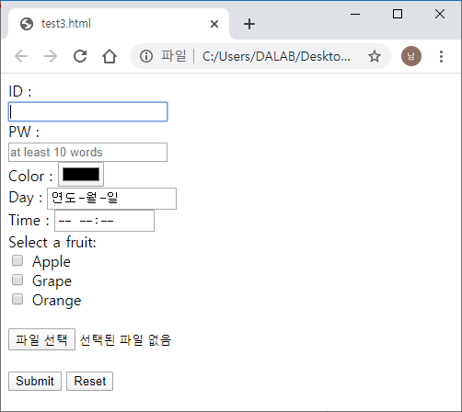
HTML Form Elements
Try other attributes
by yourself

Slide 51
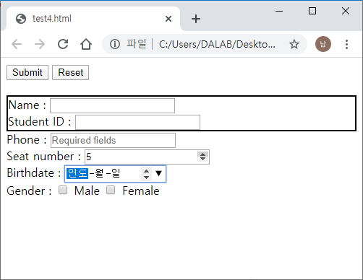
HTML Form Elements
Task 3
Create the following page using HTML form elements
1. Name, Student
-> 2px, solid, black
2. Phone
-> required, placeholder
3. Birthdate
-> autofocus

Slide 52
Homework for Lecture 4
Explain the difference between block and inline elements
Include the following tags to the personal website you created in Lecture 3
Div
Youtube video
At least 5 HTML form elements
At least 3 attributes of input elements
Create a ZIP folder that includes all necessary source code files
Deadline: March 25, 2022 12:59

